Slide 1


Car Insurance Analysis Operational Metrics
By Larissa onyeakagbu

Slide 2
Car Insurance Analysis Interpretation for Upper Management
This car insurance analysis offers a comprehensive overview of key metrics and trends using Tableau Public and LookerStudio. It provides upper management with actionable insights to optimize strategies and improve performance. Through interactive visualizations and data exploration, you've highlighted areas such as claim frequency, policyholder demographics, regional variations, and risk factors influencing premiums. By leveraging these tools, you've enabled management to make data-driven decisions, enhance customer satisfaction, and drive profitability in the competitive insurance landscape.

Slide 3
Data Preparation
Data Import: Imported the car insurance dataset into Google BigQuery, connected to an external source, selected the relevant data, and imported it into my BigQuery project.
Data Cleaning: I checked for and handled missing or inconsistent data.
Data Structuring: Ensured the data is in a format suitable for analysis. Structured the data into tables, setting appropriate data types for each column, or encoding categorical values.

Slide 4
Data Analysis
Initial Exploration: I got a sense of the data which involved looking at the number of rows and columns, the range of values in each column, or the number of unique entries for categorical variables.
Descriptive Statistics: I calculated the basic statistics for each column to have a sense of what the distribution values look like.
Data Visualization: I used plots, charts, and tables to visualize the data. This aided in identifying patterns, trends, outliers, or even relationships between variables.

Slide 5
Dashboard Creation
Key Metrics: I identified the key metrics that operational teams were interested in. This included the number of insurance policies, total claim amount, and average claim amount.
Dashboard Design: I designed the dashboard in Google Data Studio, ensuring it represents these key metrics visually and effectively.
Visualization: I included various charts and graphs such as bar graphs for different car brands, education levels, marital status and line charts for car ages and clam amount/frequency.
Interactivity: I included filters for parent, gender, car use, and other metrics to allow users to customize the view.
Dashboard: The result of this process is an in-depth interpretation which is interactive and user-friendly. This provides strategic perspectives on this analysis.

Slide 6
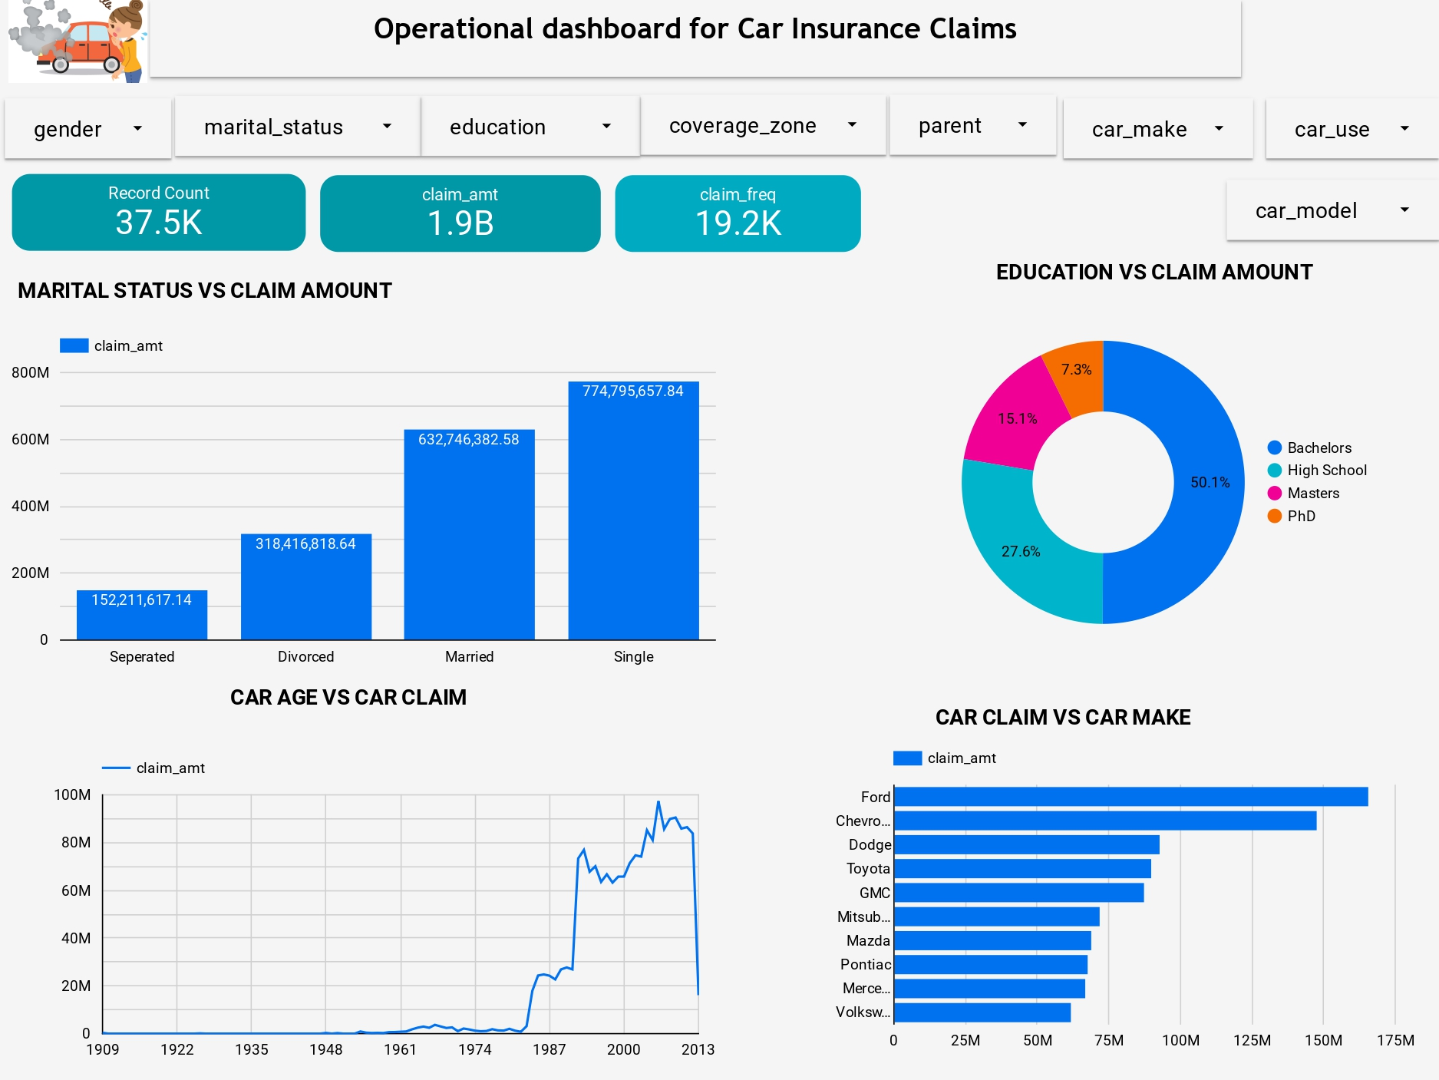

Slide 7
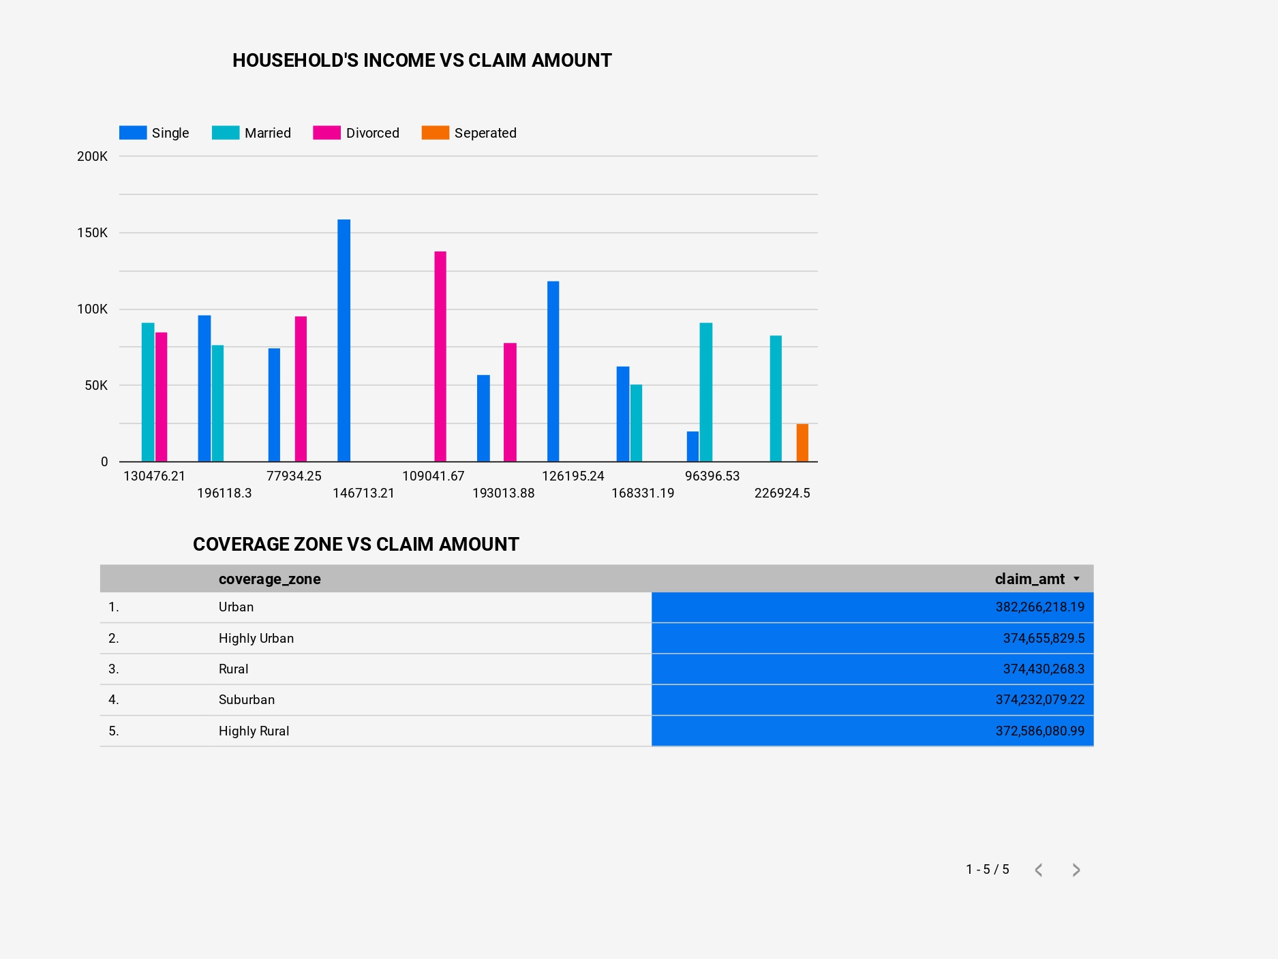

Slide 8
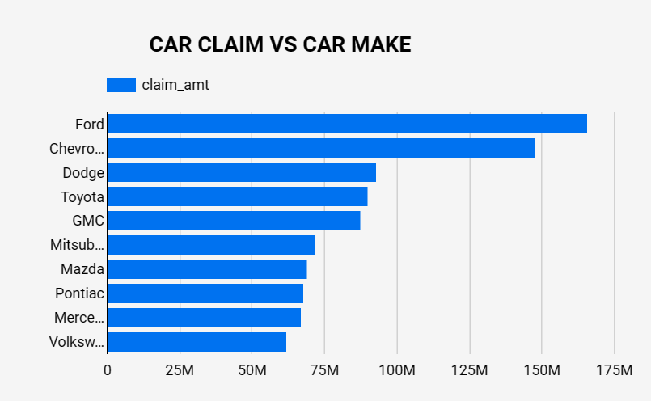
Interpretations of Findings- Claim Amt vs Car Make
Ford has the highest claim amount at approx. 165.6M. This could simply mean that Ford vehicles are either prone to accidents or damages, or the cost of repairs for these vehicles is higher.
Chevrolet follows with around 147.9M in claims. Like Ford, this could mean a higher incidence of claims or higher repair costs.
Dodge has approx. 92.9M in claims, which is significantly lower than Ford and Chevrolet.
Toyota’s claims about 90.1M, which is slightly lower than Dodge.
GMC has the lowest claim amount at approx. 84.7M.

Slide 9
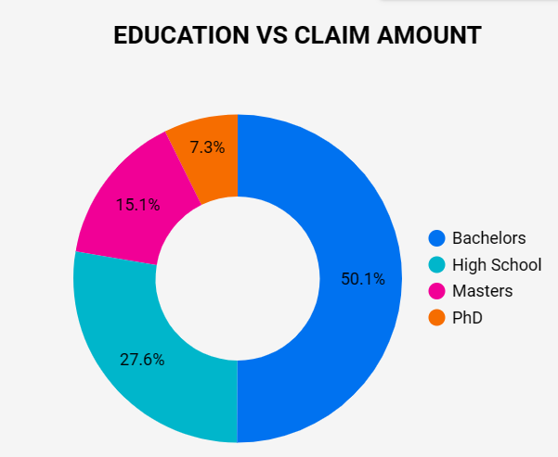
Interpretations of Findings- Claim Amt vs Education
Bachelors: Individuals with this degree have the highest claim percentage of approx. 50.1%.
High School: Here, these individuals have the second highest claim percentage of approx. 27.6%.
Masters: Master’s degree holders show a claim percentage of 15.1%, which is lower than the first two groups. This could be due to a variety of factors such as car type, driving habits, or insurance coverage.
PhD: Individuals with a PhD have the lowest claim percentage at approx. 7.3%. This means that this group might own less expensive cars, drive less often, or engage in safer driving practices.

Slide 10
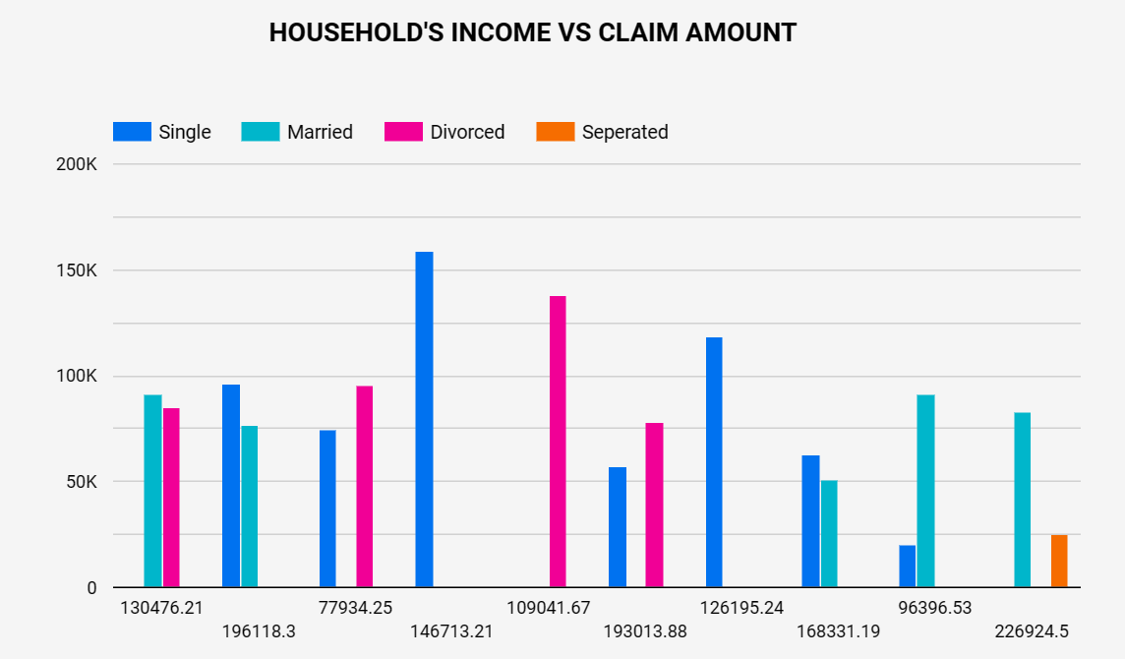
Interpretations of Findings- Claim Amt vs Income
Married: Married individuals have moderate household income but high claims. This could be because married couples tend to own more expensive cars per household, leading to higher claim amounts.
Divorced: Here, these individuals have lower household incomes but relatively high claim amounts. This could be due to different factors such as car type, driving habits, or insurance coverage.
Separated: These individuals have the lowest household income and also they claim amounts among all categories. This could mean that separated individuals own less expensive cars, drive less, or have lower insurance coverage.
Single: Single individuals have both higher household incomes and claims. This could suggest that they might own more expensive cars or engage in risky driving habits.

Slide 11
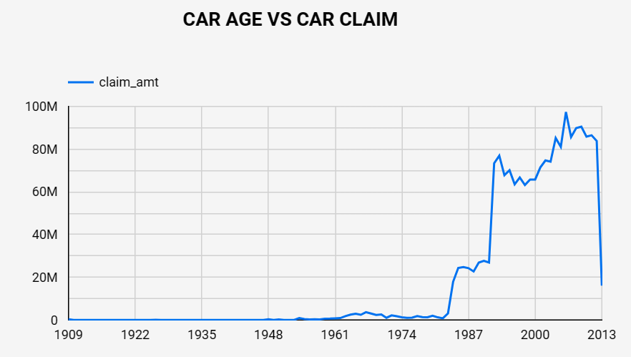
Interpretations of Findings- Claim Amt vs Car Age
Young Cars (11 years): Relatively new Cars have lower claim amounts. This is because of mechanical issues and the presence of advanced safety features in newer models.
Middle-aged Cars (12-30 years): Here, these cars in this age range have the highest claim amounts, peaking at around 18 years. This could be because of increased mechanical issues as the car ages, leading to more claims.
Old Cars (40+ years): The claim amount decreases for cars older than 15 years and remains relatively low. This could mean that older cars are likely to be driven less frequently or have lower repair costs due to cheaper parts.

Slide 12
Recommendations
DATA MANAGEMENT: Accurate and up-to-date data is vital for analysis. Always ensure that data on all car metrics are accurately recorded and updated.
CLAIM PROCESSING: My analysis shows higher claim frequencies from certain customer segments. This might involve staffing rearrangements or process improvements in the claim processing department to handle higher volumes.
COMPETITIVE BENCHMARKING: Conduct benchmarking against competitors to gain insights into market positioning and performance. Compare metrics such as premium rates, claim processing times, and customer satisfaction scores. Identify areas where your company excels and opportunities for improvement to maintain a competitive edge in the market.
PREDICTIVE MODELING FOR RISK ASSESSMENT: Implement predictive modeling techniques to improve risk assessment and pricing strategies. Leverage historical data and advanced analytics to forecast future claim frequency and severity accurately. Adjust pricing models accordingly to reflect risk exposure accurately while remaining competitive in the market.
SEGMENTATION FOR TARGETED MARKETING: Utilize customer segmentation derived from the analysis to tailor marketing efforts effectively. Identify high-value customer segments based on factors such as driving behavior, policy preferences, and demographics. Craft personalized messaging and offers to enhance customer engagement and retention.

Slide 13
Thank You
- thecoderblue7

